Slide 1
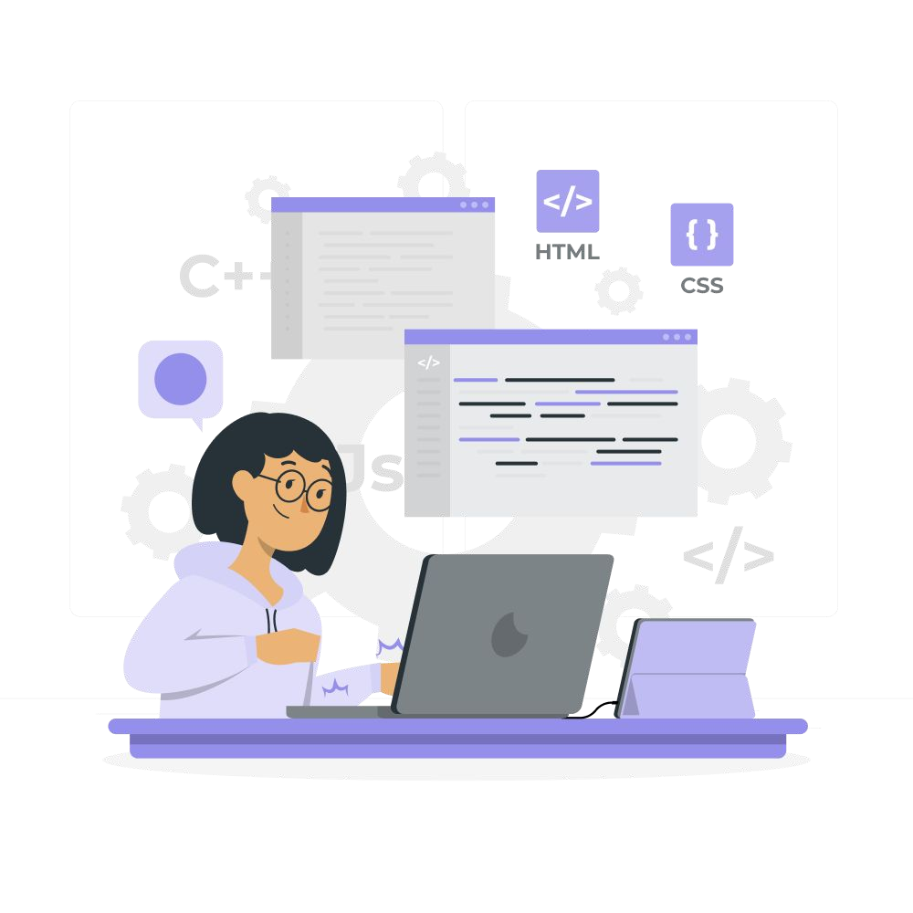

Getting started with programming

Slide 2

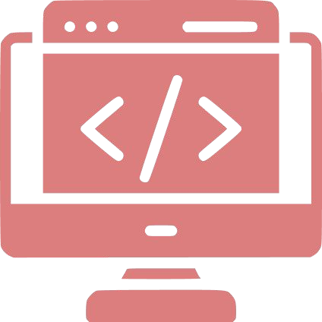

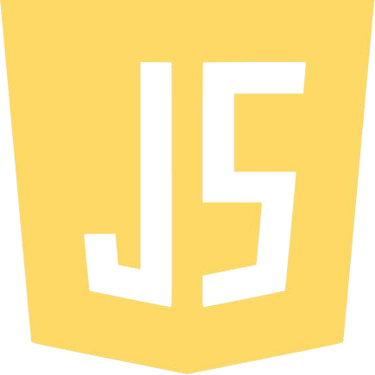


Topics Covered
Introduction
Diﬀerent types of Programming Paradigm
Diﬀerence between Scripting & Compiled Language
What is JavaScript?
Tips & Tricks
Practice Questions

Slide 3

Why is Programming important?
Programming allows us to make use of computers to solve complex mathematical equations or render a 4K video to be uploaded on YouTube or using Google Docs to write this document that you are reading currently.
Everything and anything that can be done on a computer is done using programming, anything you do on a computer, be it a game you play(Counter Strike/ Project IGI), video you watch on YouTube or an application you run like MS Word, it is done using programming, each of these items contains thousands of lines of instructions telling the computer what to do and thus we get to run them smoothly on our computers.
Not everything can be done manually by human beings, certain tasks require automation, and there are computations that the human mind cannot always accurately state.

Slide 4
Thus to reduce manual work, improve eﬃciency and automate labor, programming was introduced as a means to solve the problem.
Programming can be done using a variety of computer programming languages, such as JavaScript, Python, and C++.

Slide 5
Diﬀerent types of Programming Paradigms?
There are basically four types of programming:
Procedural
Object Oriented
Functional
Declarative

Slide 6

Procedural Programming:
Procedural programming is a programming paradigm that evolved from structured programming and is based on the concept of invoking procedures. Procedures, often known as routines, subroutines, or functions, are essentially a set of instructions to be followed. Any procedure in a programme can be invoked at any time during execution, either by other procedures or by the programme itself.
As the name implies, a procedural language relies on speciﬁed and well-organized procedures, functions, or sub-routines in a program's architecture to express all the steps that the computer must follow to attain a particular state or result.

Slide 7
Procedural Programming:
A programme is divided into variables, functions, statements, and conditional operators using the procedural language. To complete a task, procedures or functions are applied to the data and variables. These procedures can be called/invoked from any point in the programme hierarchy, as well as from other procedures. One or more processes can be found in procedural language software.
Procedural language is one of the most common types of programming languages in use, with notable languages such as C/C++, Java, ColdFusion and PASCAL.

Slide 8
Procedural Programming:
When it comes to the following situations, procedural programming is often the best option:
There's a complicated operation with inter - dependencies and a need for clear visibility of multiple program states ('SQL loading,"SQL loaded,'Network online,'No audio hardware,' and so on). This is usually the best way to start and stop an application.
The program is one-of-a-kind, with only a few elements in common.
The program is set in stone and is unlikely to change signiﬁcantly over time.
Over time, it is envisaged that no or just a few features would be added to the project.

Slide 9

Object Oriented Programming:
Object-oriented programming is a programming paradigm based on the concept of objects, which contain data as well as code to manipulate it. Object-oriented programming imitates many of the characteristics of real-world objects.
Objects are made up of data and methods that describe their state and behaviour. These two entities are encapsulated in each object.
The user cannot see how object methods are implemented inside. This allows objects to alter their abstract state using a simple external API.
Classes have instances, which are objects. Classes serve as blueprints for constructing objects. An object's type is also its class.
Other classes' state and behaviour can be inherited by classes. Objects of the subclass can be cast into objects of the parent class based on this concept.
Polymorphism is a result of this type of casting. An object of a class can be implicitly cast to an object of the class's predecessors by the programme.

Slide 10
Object Oriented Programming:
OOP is frequently the better choice when:
We have a team of programmers who don't need to know everything about every component.
There's a lot of code out there that can be shared and reused.
The project is expected to alter frequently and be expanded over time.
Diﬀerent resources, such as datasets or hardware, can assist diﬀerent portions.
When we have numerous developers that need to share implementation details, we probably don't want to use it. For example, if we were creating a keyboard driver, we wouldn't want to break it up into pieces that would hide implementation details from a developer working on the driver.

Slide 11

Functional Programming:
Functional programming languages were created speciﬁcally for symbolic computing and list processing. Mathematical functions are the foundation of functional programming. Lisp, Python, Erlang, Haskell, Clojure, and other functional programming languages are some of the most popular.
The following are the most notable features of functional programming:
Functional programming languages are based on the concept of mathematical functions that execute computations using conditional expressions and recursion.
Higher-order functions and slow evaluation are supported by functional programming.
Flow is not supported by functional programming languages. Loop statements and conditional statements such as If-Else and Switch Statements are examples of controls. They use functions and functional calls directly.

Slide 12
Functional Programming:
When should functional programming be used:
Domain speciﬁc languages (DSLs): If the issue domain is so complex that traditional industry languages like Java and C/++ fail to address it eﬃciently, a DSL might be the answer.
We wouldn't use a DSL to construct our entire system, but we could use it, like the 5ESS switch, to code a critical function in a way that is easier to understand and maintain, ensuring its quality.
DSL creation is a breeze with functional languages.

Slide 13

Declarative Programming:
Declarative programming is deﬁned as writing code that deﬁnes what you want to achieve rather than how you want to do it. It's up to the compiler to ﬁnd out how to do it.
Declarative programming refers to a set of problems for which the language implementation is responsible for ﬁnding a solution. Some parallel processing systems beneﬁt from declarative programming since it simpliﬁes the programming.
SQL and Prolog are two declarative programming languages.

Slide 14
Declarative Programming:
Declarative programming is useful in the following situations:
When we want to keep the code factorable and clean.
When readability of the code is to be given utmost importance.
When database queries need to be placed.

Slide 15
Diﬀerence between Scripting vs Compiled Language:
Scripting languages are, in essence, programming languages. The distinction between the two is that scripting languages do not require compilation and instead are interpreted. A C program, for example, must be compiled before running, whereas a scripting language like JavaScript or PHP does not require compilation.
Compiler programs are generally faster than interpreter programs since they are transformed from native machine code ﬁrst. Furthermore, compilers examine and interpret code just once, reporting any faults that the code may contain collectively, whereas the interpreter reads and analyses code statements each time it encounters them, stopping immediately if there is a mistake. In fact, the gap between the two is blurring due to modern hardware's better calculation capabilities and innovative coding approaches.

Slide 16
Diﬀerence between Scripting vs Compiled Language:
Some scripting languages traditionally used without an explicit compilation step are JavaScript, PHP, Python, VBScript.
Some programming languages traditionally used with an explicit compilation step are C, C++.

Slide 17
Diﬀerence between Scripting vs Compiled Language:
Scripting Languages in Practice:
To programmatically automate some operations
Information extraction from a data set
Requires less code than standard programming languages.
Programming Language Applications:
They are usually run within a parent application, similar to scripts.
More consistent with mathematical models when integrating code
Programming languages such as JAVA can be compiled and run on any platform.

Slide 18
What is Javascript?:
JavaScript is a programming language that enables developers to create API and call the external API. It Is commonly used as part of web pages.
It is lightweight and can be interpreted in an object-oriented manner.
JavaScript was initially called LiveScript, but Netscape changed it to JavaScript, which is because
Of the excitement, it has generated.
JavaScript is a programming language that provides an interface to the server-side. It allows developers to create interactive and non-standard web applications.
Client-side JavaScript is a type of programming language that is commonly used for web apps.
A web page is not a static HTML document but can include interactive software that can interact with the user.

Slide 19
What is Javascript?:
JavaScript is a programming language that enables developers to create interactive and non-static web pages. It serves as the third layer of web.
The three layers are built on top of one another.
It is used to create API using express JS in node JS

Slide 20

Why is it important ?
JavaScript is used to create an API:
Create an API and connect to database using javascript libraries.
Large support in open source community
Easily integrate all the other services with the backend of any of the application
Easy to learn other popular javascript framework and libraries since these are build on top of the Javascript
Playing audio and video.
Validating input from the backend.

Slide 21

Where is it used?
It allows developers to create API to access data from database and pass it to any other purpose
Development, being on client side and it’s used as an backend service as well. Some of the popular javascript backend frameworks and libraries are: Express JS
JavaScript allows users to connect databases
The following are examples of backend modiﬁcations that you may apply to a service using JavaScript :
Connect Databases SQL or NoSQL.
Create an API using Express JS
Validate the data in the backend for authentication
On event we can handle any error
Used for authentication and authorization

Slide 22

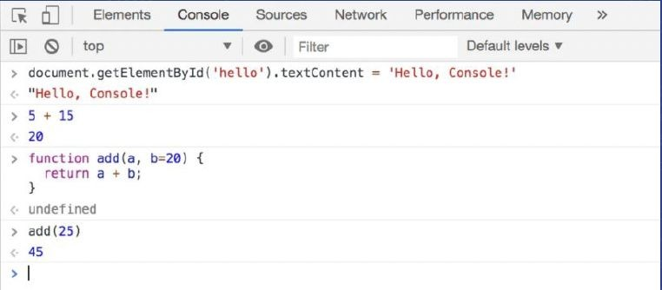
How to run JavaScript?
JavaScript is a scripting language so it cannot run on it’s own.
The code executes in a browser environment like internet explorer, google chrome, ﬁrefox etc.

Slide 23
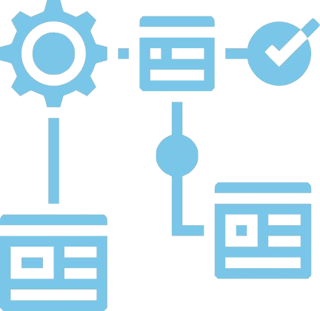
JavaScript DataTypes
Data types are used to store speciﬁc types of data and can be used to manipulate it accordingly.
var x; // x is undefined
x = 12; // x is a Number
x = "John"; // x is a String

Slide 24

Comparison operators:
You can ask questions and compare any two values together.
You will get a boolean value in output: “TRUE” or “FALSE”
We will use console.log() :
This shows the result in the web console.
To open web console:
type Ctrl + SHift + I on windows or linux
Type Cmd + Shift + K on mac
You can write click on the browser => inspect => console

Slide 25
Example :
<Script>
// are these two values equal console.Log(2 == 3) ;
// is the first value less than second console.Log(2 <== 3) ;
</Script>

Slide 26
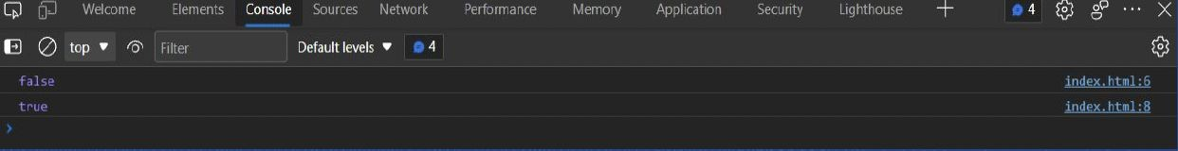
Output :

Slide 27
Example :
var x; // x is undefined
X = 12; // x is a Number X = “John”; // x is a String
String :
Use to store text value
Enclosed by quotes
Can use single quotes : ‘ ’
Can use double quotes : “ ”
Can use backticks: ` `

Slide 28
Example :
var name = "John"; var lastName = "Doe";
var fullName = `My name is ${name}
${lastName}`; console.log(fullName);
// output:
//My name is John Doe

Slide 29
Number
Use to store numbers (positive and negative numbers)
Inﬁnity values represents the mathematical Inﬁnity, the greatest number
Inﬁnity value represent the smallest number
Nan : Not A Number: invalis numeric value

Slide 30
Example :
var a = 12; // number, integer
var | b | = | 12.1; // number ,floating point number
var | c | = | 16/0; // Infinity
var | d | = | 16/-0; // Infinity
var | e | = | “text”/2 // NaN

Slide 31
THANK YOU

Slide 32





Topics covered : use icons from the scratchpad on your Figma ﬁle
Introduction
Side Eﬀects of Functions
Scopes and Bindings
Closures
Higher Order Functions and Abstraction
Composability
Practice questions
FED-Class 44

